Slide 1
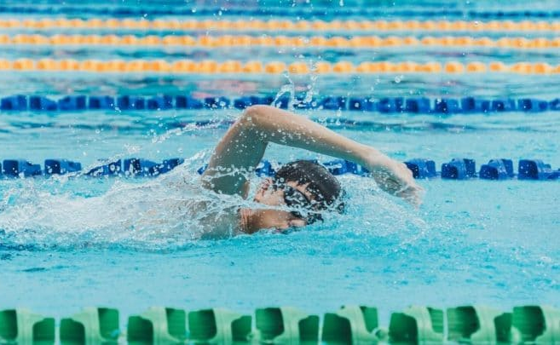
SwimFix Platform for Improving Front Crawl
Roee Groiser Tom Marzea Liron Abraham

Slide 2



Our Team
Tom Marzea
Liron Abraham
Roee Groiser

Slide 3
Motivation
In the competitive sports field, the result matters - nevertheless the training matters.
The training has a direct impact over the result, especially in the swimming field.
There are many challenges both in the coacher and swimmer aspect during swimming training sessions – and we would like to overcome these challenges efficiently.
Solution?
SwimFix

Slide 4
About SwimFix
SwimFix is a platform for improving front crawl based on a video of the swimmer.
Helps the coacher to detect errors for multiple swimmers at a time.
Gives the coacher another view of the swimmer under the water.
The entrepreneurs are Dr. Raziel Riemer and Dr. Gera Weiss.

Slide 5
Our Services
Front Crawl Swimming Assessment
Pose Estimation
Model Testing
Pose Estimation Model Training

Slide 6
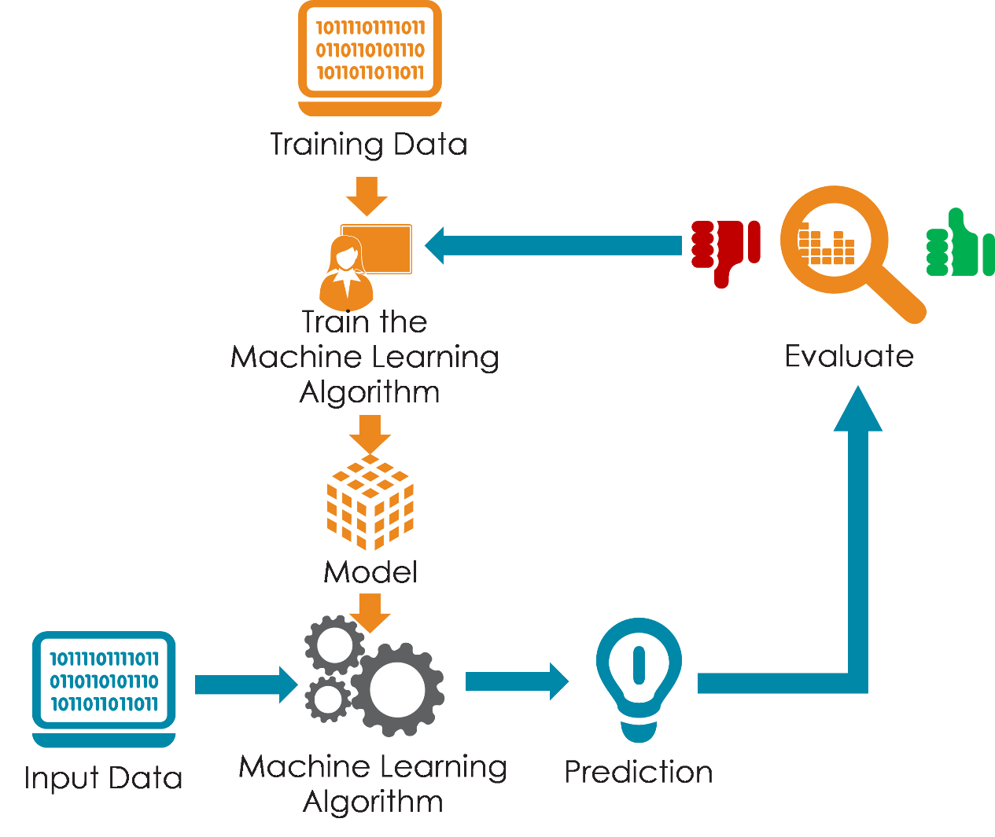
SwimFix Logic

Slide 7



The Assessment Pipeline
Upload a Video
The Video Is Being Processed
Receive A Feedback

Slide 8





Video Pre-Processing
1990
Keypoint Detection
1995
Keypoints Pre-Processing
2000
Angles Extraction
2005
Error Detection and Final Score
2010

Slide 9
Video Pre-Processing
1990
Keypoint Detection
1995
Keypoints Pre-Processing
2000
Angles Extraction
2005
Error Detection and Final Score
2010

Slide 10
Video Pre-Processing
A module for cutting out only the relevant parts from a swimmer's video
Why?
We want to minimize the data sent to the server in order to save time analyzing a video on the server.
How does it work?
Defining what the background is: Gray-scale and blur the first frame
For each frame: convert it to gray scale
Calculate the absolute difference with the background
Finding the biggest contour
Calculate trending using the area of the contour
If the area is bigger than the predefined threshold and the trending is positive in the past second- start the recording if its off
If not for a predefined number of frames- stop recording

Slide 11
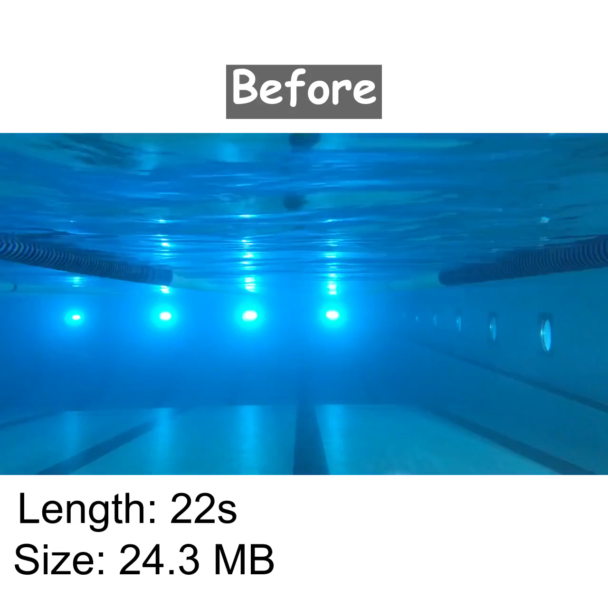
Before and After

Slide 12
Video Pre-Processing
1990
Keypoint Detection
1995
Keypoints Pre-Processing
2000
Angles Extraction
2005
Error Detection and Final Score
2010

Slide 13
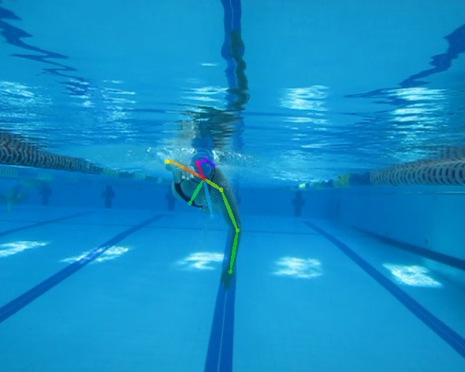
Keypoint Detection
Given a swimming video in a front crawl setting, the pose estimation tool detects different keypoints of the swimmer in each frame and extracts analytical measures which are later used to assess the performance of the swimmer.

Slide 14
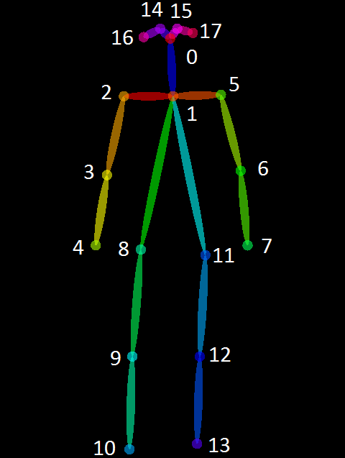
Keypoint Detection - OpenPose
C++ open-source library for pose estimation
Detects people in a video and extracts wireframes of them
The wireframe includes 18 keypoints
Since our project is about front-crawl swimming style- these are the points that are relevant to us

Slide 15
Video Pre-Processing
1990
Keypoint Detection
1995
Keypoints Pre-Processing
2000
Angles Extraction
2005
Error Detection and Final Score
2010

Slide 16
Keypoints Pre-Processing
The quality of the performance assessment tool is directly affected by the accuracy of the keypoints detection tool.
Therefore pre-processing of the detected keypoints is needed in case the detection is not satisfying enough.
Given the keypoints, the algorithm filters the most useful ones using the score of each keypoint and performs the pre-processing on them.

Slide 17
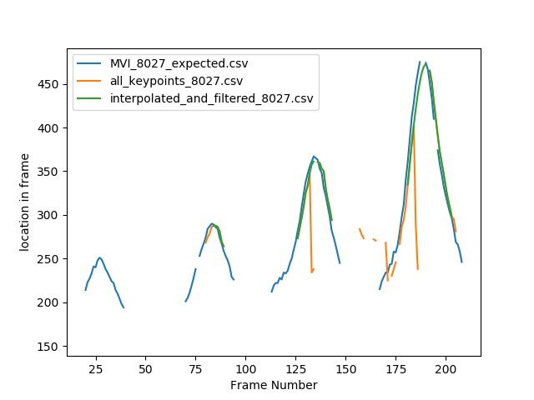
Keypoints Pre-Processing
Left Wrist Y Location Depends on Frame Number
The Algorithm:
For each body part:
Search for sequences of frames with score > threshold and with minimum length.
2. Merge between the sequences.
3. Extend each sequence.
4. Delete data of body part from frames outside of the sequences.

Slide 18
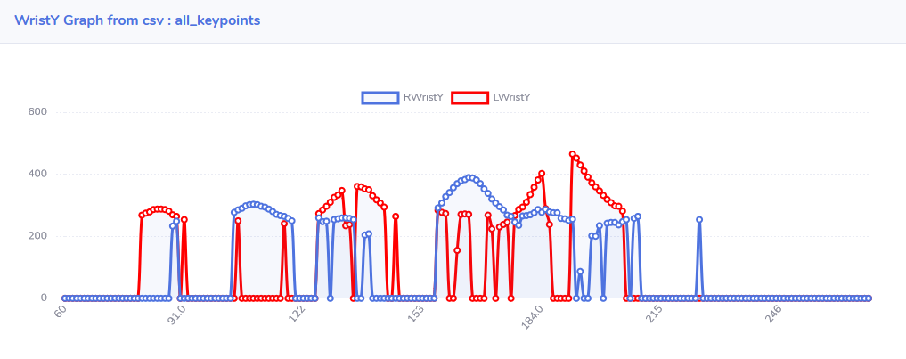
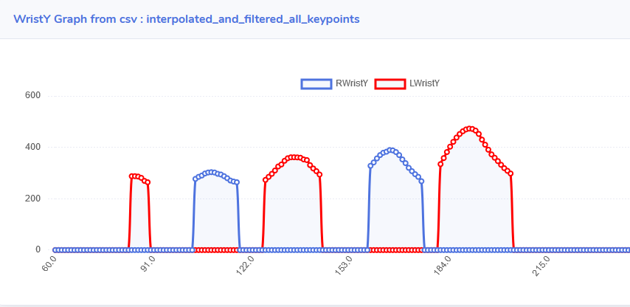
Before
After

Slide 19
Video Pre-Processing
1990
Keypoint Detection
1995
Keypoints Pre-Processing
2000
Angles Extraction
2005
Error Detection and Final Score
2010

Slide 20
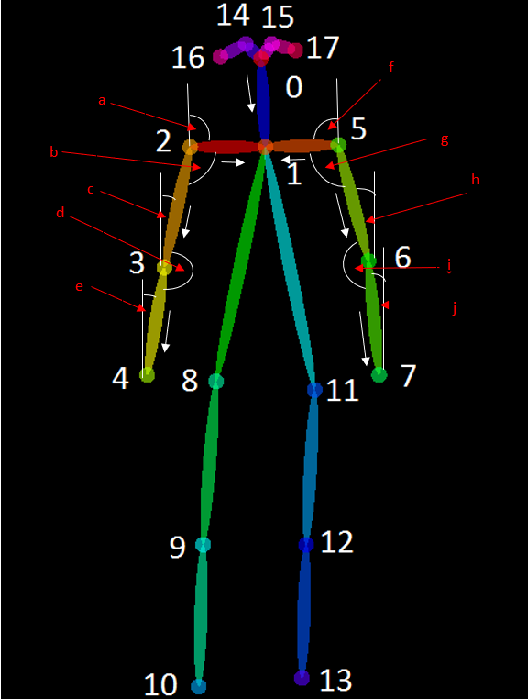
Angles Extraction
Using the keypoints extracted from the previous step we calculate the vectors and angles between them
a - Global right shoulder angle b - Right shoulder angle c - Global right arm angle d - Right elbow angle e - Global right forearm angle f - Global left shoulder angle g - Left shoulder angle h - Global left arm angle i - Left elbow angle j - Global left forearm angle.

Slide 21
Video Pre-Processing
1990
Keypoint Detection
1995
Keypoints Pre-Processing
2000
Angles Extraction
2005
Error Detection and Final Score
2010

Slide 22
Error Detection and Final Score
This is the final step in the process is detecting errors of the swimmer.
The quality of the error detection is directly affected by the accuracy of the data extracted before.
This step uses analytical measurements, in order to check if some error occurred and in which frames.
The final score is calculated according to the number of error instances.

Slide 23
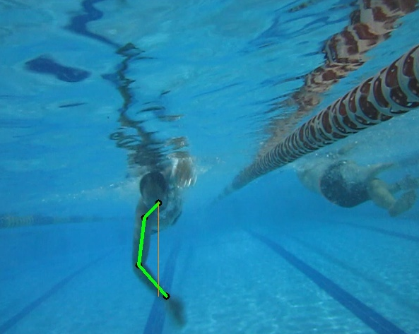
Error Detection and Final Score
Examples
Palm crossed the middle line (neck line).
Happens when swimmer crossed his hand too much with his body.

Slide 24
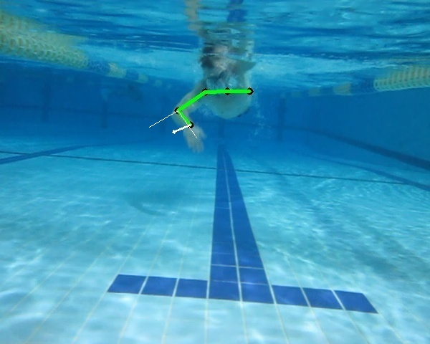
Error Detection and Final Score
Examples
Elbow is too flexed (Elbow is locked error can be detected as well). When detecting this error, angle i is checked.

Slide 25
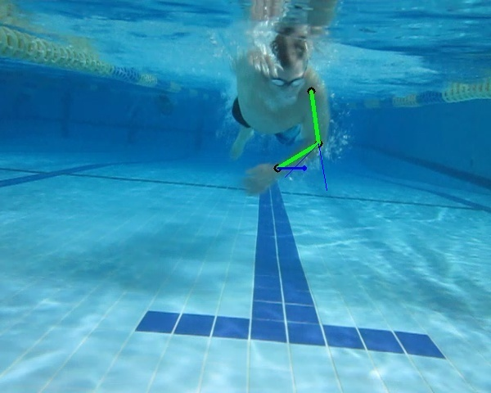
Error Detection and Final Score
Examples
The forearm is too flexed (angle j is too big when hand is directed to the inner part of the body)

Slide 26
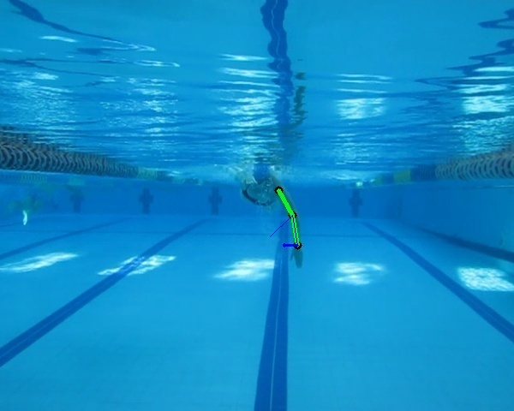
Error Detection and Final Score
Examples
The forearm is too open (angle j is too big when the hand is directed outside)

Slide 27
Error Detection and Final Score
In order to detect more types of errors we have designed a module called “Plug and Play” which we will discuss later in the presentation.

Slide 28
Plug and Play
This feature supplies the ability for developers to add new swimming errors definitions for future analysis in addition to our default errors.
We enable uploading a python file containing a function in a specific format
The functions on these files are executed in the error detection step

Slide 29
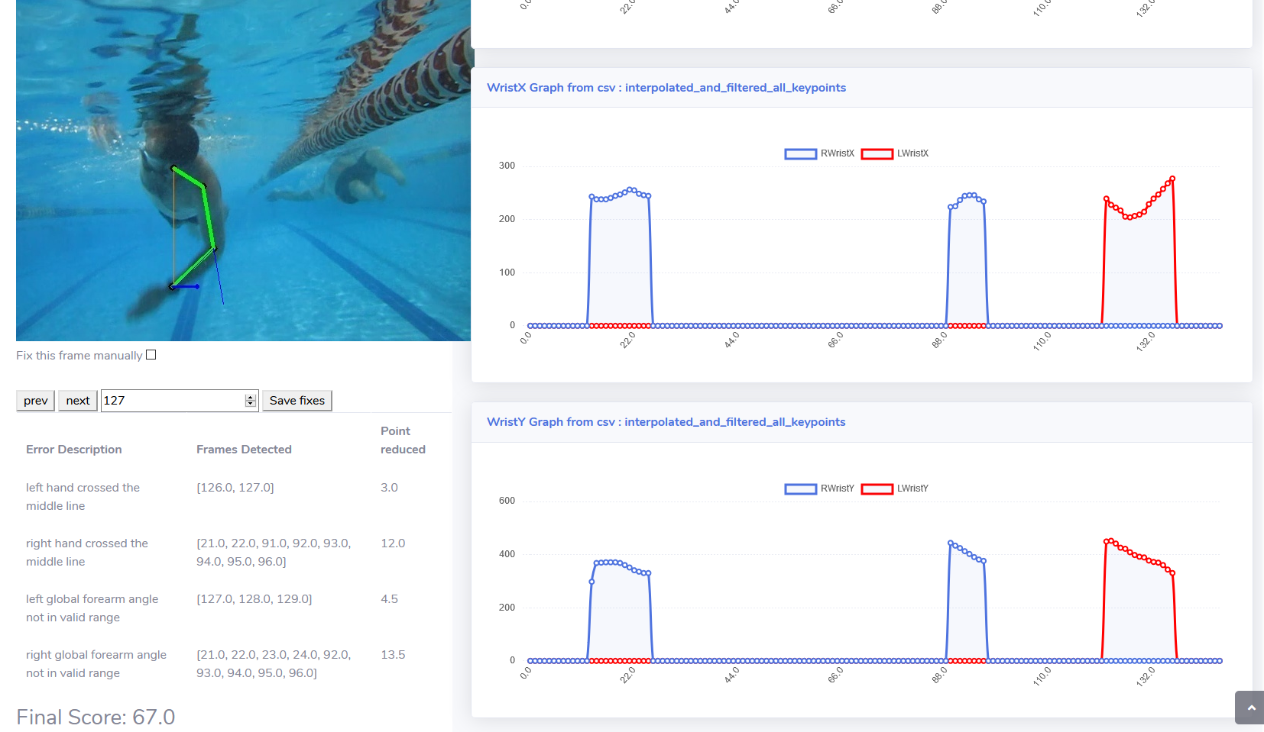
Assessment Feedback

Slide 30
Testing
The assessment tool is based on the ability to detect keypoints
There is a need for a ground truth for comparison.
The tests compare each available movie with the ground truth uploaded to the system and outputs the difference between data produced in the system, and data that taken from the manual annotations.

Slide 31



The Testing Pipeline
Upload a Video
Annotate Keypoints
Manually
Get CSV with Ground Truth
Upload the CSV and Run the Test

Slide 32
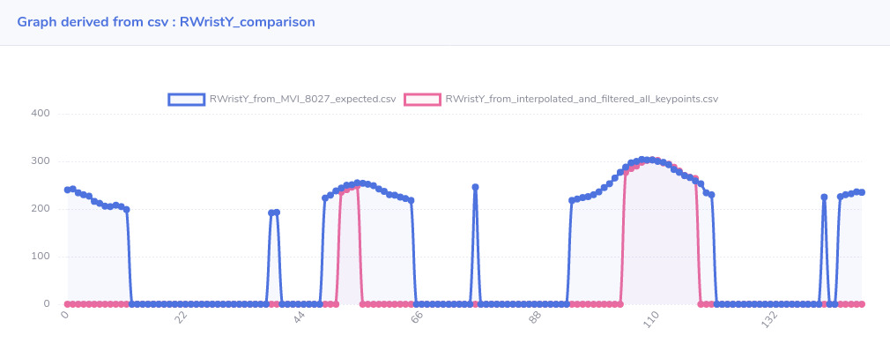
Testing - Graphs
The test module runs the system in order to get the actual data, and makes another calculations on the data stored in the ground truth files.
For each pair of output files with the same format and meaning, the test unites them into 1 comparison file that compares 2 sequences of data. From this file, the system generates graph that showing the difference between our system’s output to the expected one.

Slide 33
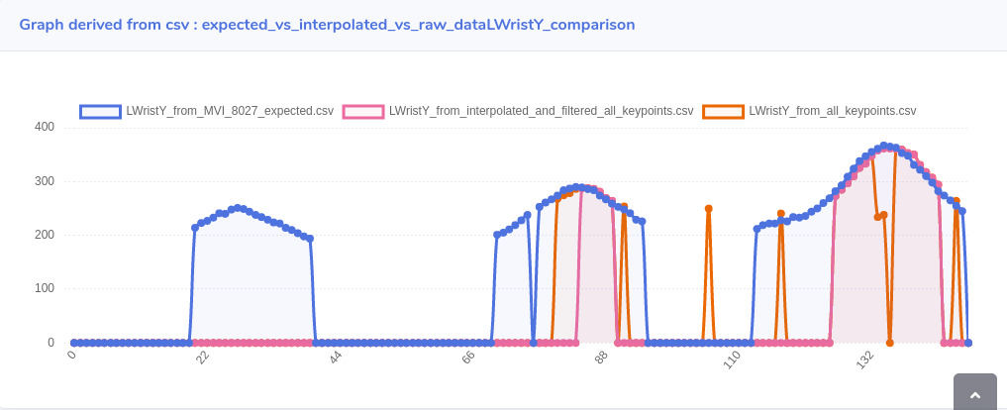
Testing - Graphs
It also checks the keypoints filtration algorithm.
Foreach keypoint, the test compares 3 keypoint coordinates sequences : the output got from OpenPose (the input to the filtration algorithm) , the expected data (i.e the ground truth) , and the keypoint coordinate got from filtration algorithm.

Slide 34
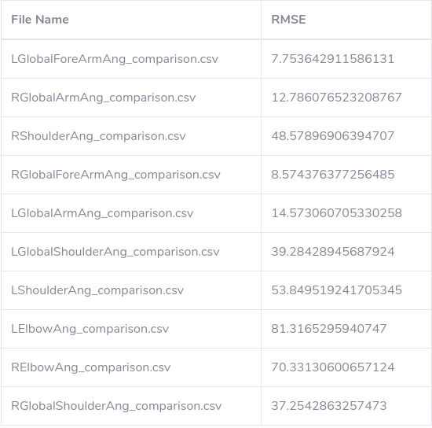
Testing - Graphs
The test module shows numeric values reflecting the difference between the expected and the actual output.
The numeric value is actually the loss value calculated by the RMSE metric.

Slide 35
Model Training

Slide 36
Model Training - Motivation
The assessment tool is based on keypoint detection
Thus, the quality of the product is determined by the quality of the keypoint detection – we want the detection to be as accurate as possible since the accuracy affects the final output and the overall assessment.
The keypoint detection is performed by the pose estimation model, so improving the model’s accuracy will result in a better product.
We would like to train a model in order to reach higher accuracy.

Slide 37
Training Infrastructure
Our platform offers an infrastructure for training your own model on your own data.
The model will later be used in our performance assessment tool in the keypoint detection step.

Slide 38
The Data Preparation Pipeline
​Our platform allows developers to train a model from scratch with any data they want.​
All you need to do is to supply the training data for the model and pass it through our data preparation pipeline, and you are good to go.
You Bring the Data
We Train the Model

Slide 39




The Data Preparation Pipeline
Start Training
Configure the model architecture and different training parameters and start the training
04
STEP
Trained Model
Preprocessing
Preprocess the annotated data by filtering it and re-indexing
Augment & Transform
Perform data augmentation and transformation so it can fit as input to the model
02
STEP
03
STEP
Preprocessed Data
Manual Annotation
Annotate the raw data manually using the COCO Annotator tool
01
STEP
Raw Data

Slide 40
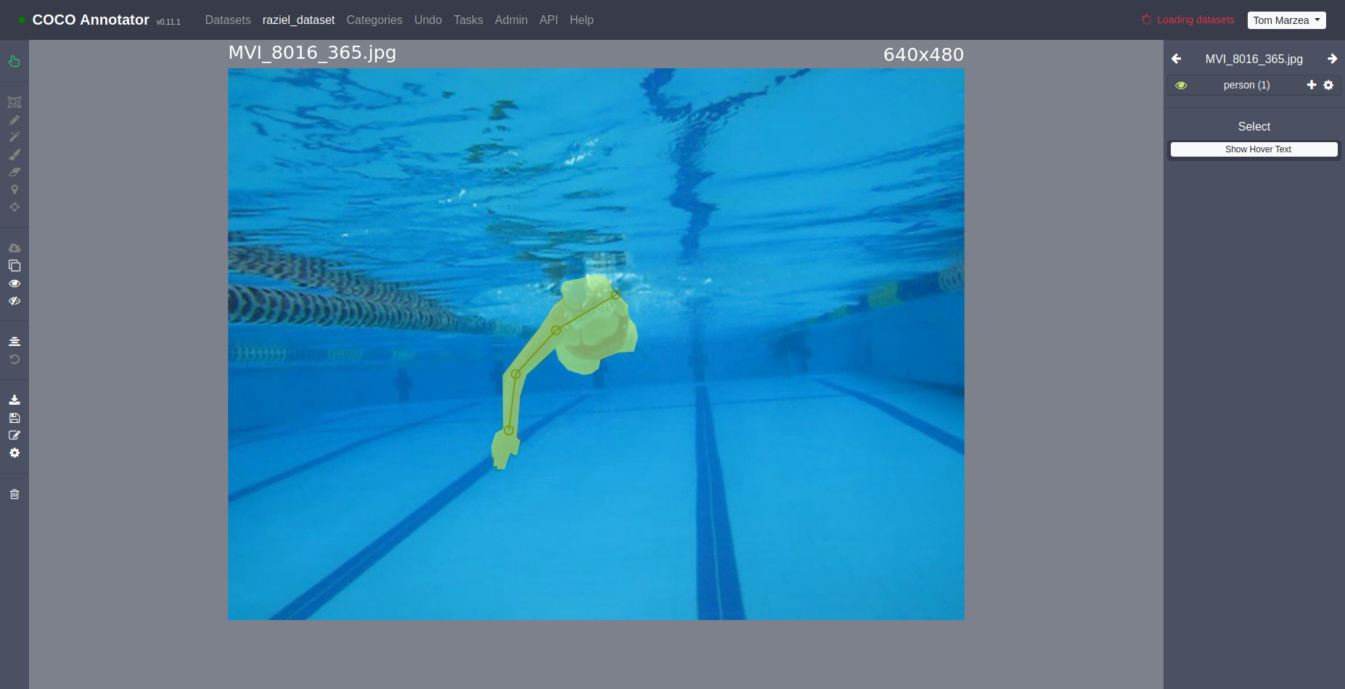
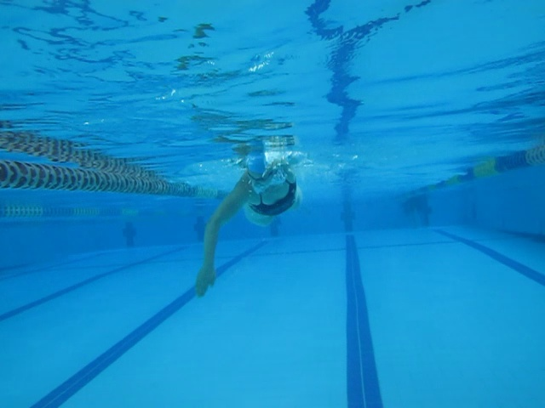
Data Annotation with COCO-Annotator
Before Annotation
After Annotation

Slide 41
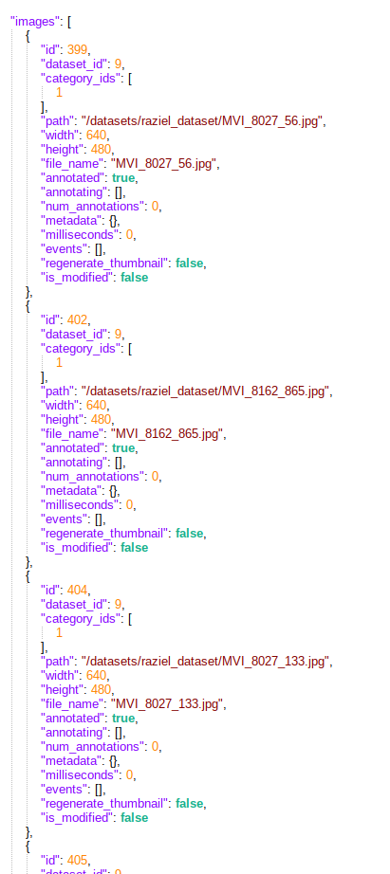
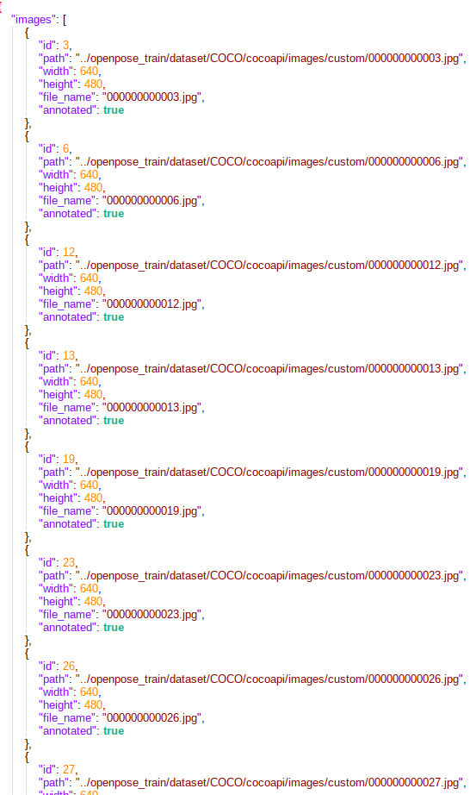
Annotated Data Filtering and Re-Indexing

Slide 42
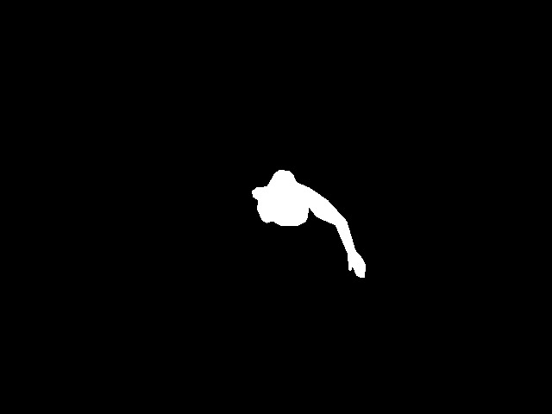
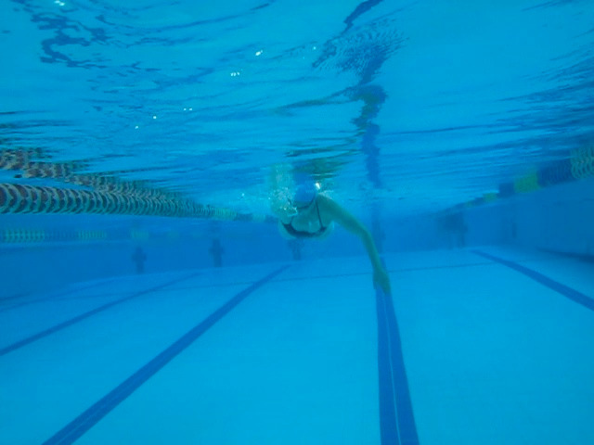
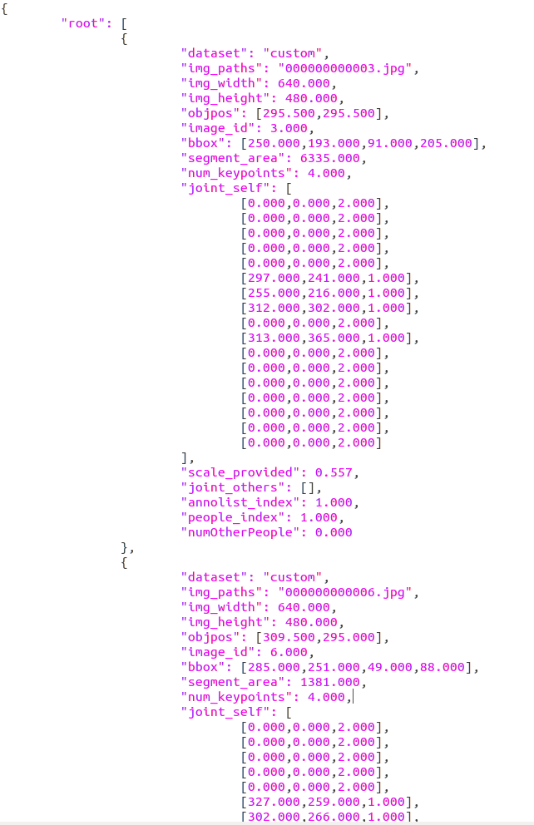
Data Augmentation and Transformation

Slide 43
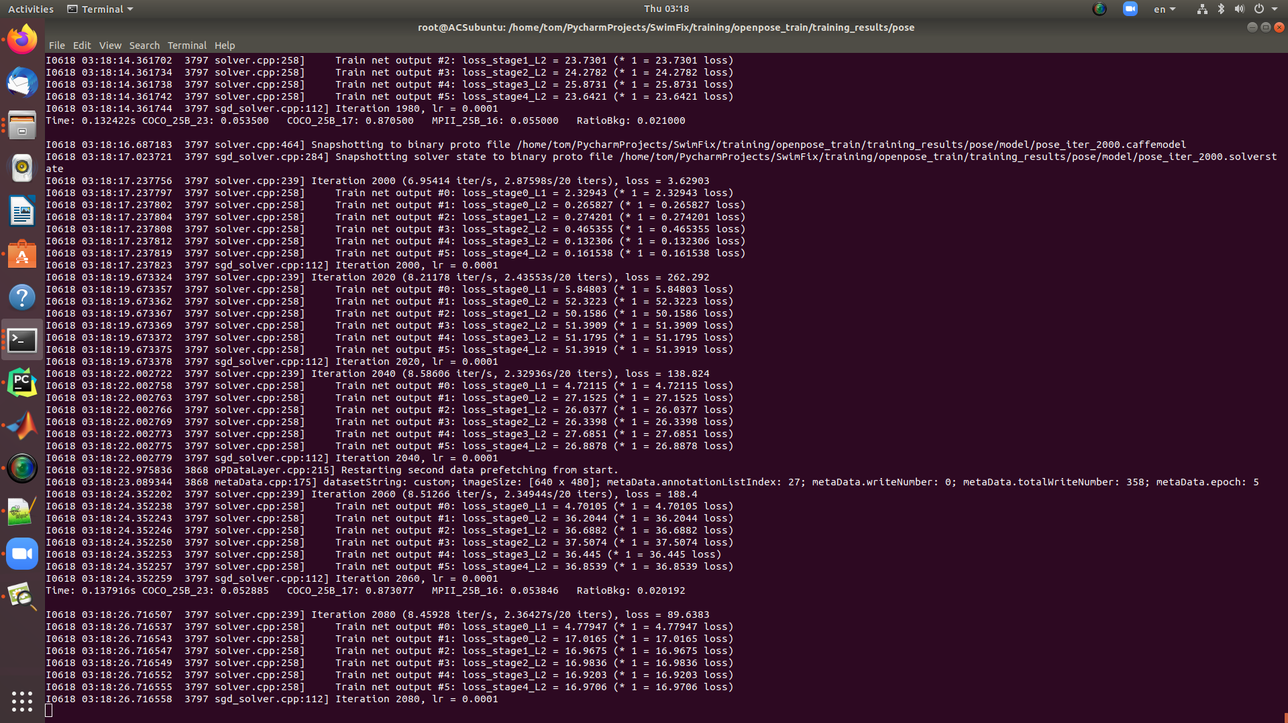
Training
Model Checkpoint
Iteration Number
# of Iterations per Seconds
Training Loss
Learning Rate
Starting another epoch over the whole training set

Slide 44

Questions

Slide 45
Thank you!

